Slide 1
HNDIT1012 Visual Application Programming
Week 10

Slide 2
Introduction to DataSet in C#
DataSet is a disconnected architecture it represents the data in table structure which means the data into rows and columns. Dataset is the local copy of your database which exists in the local system and makes the application execute faster and reliable. DataSet contains collection of DataTables. DataSet works like a real database with an entire set of data which includes the constraints, relationship among tables, and so on. It will be found in the namespace “System. Data”.

Slide 3
How DataSet Works?
Let’s understand the working procedure of DataSet in C# with example, We creating two data tables
Employee and
Salary tables
and then create data columns to add the columns into the tables and finally create data rows to add records into both the tables.

Slide 4
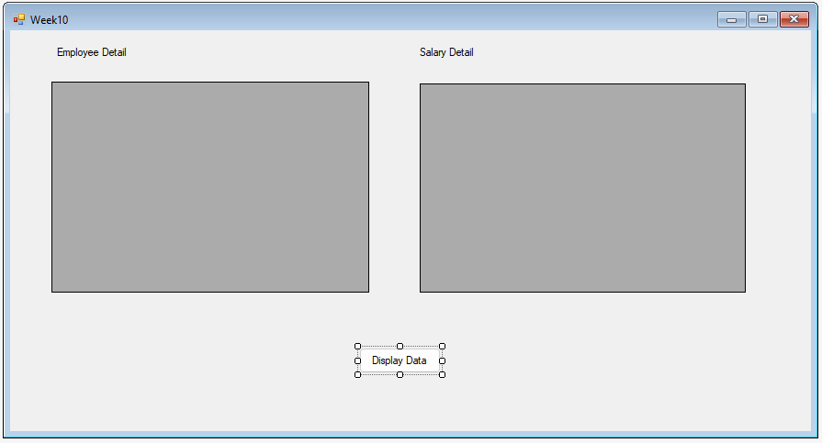
Create an Application

Slide 5
Example
Add two dataGrideView controls as shown in previous slide and insert a Button and labels as shown in previous slide.
Add the following code to the click event of the button.

Slide 6
private void button1_Click(object sender, EventArgs e)
{
// building the EmployeeDetails table using DataTable
DataTable EmployeeDetails = new DataTable("EmployeeDetails");
//to create the column and schema
DataColumn EmployeeID = new DataColumn("EmpID", typeof(Int32));
EmployeeDetails.Columns.Add(EmployeeID);
DataColumn EmployeeName = new DataColumn("EmpName", typeof(string));
EmployeeDetails.Columns.Add(EmployeeName);
DataColumn EmployeeMobile = new DataColumn("EmpMobile", typeof(string));
EmployeeDetails.Columns.Add(EmployeeMobile);
//to add the Data rows into the EmployeeDetails table
EmployeeDetails.Rows.Add(1001, "Andrew", "9000322579");
EmployeeDetails.Rows.Add(1002, "Briddan", "9081223457");
// to create one more table SalaryDetails
DataTable SalaryDetails = new DataTable("SalaryDetails");

Slide 7
//to create the column and schema
DataColumn SalaryId = new DataColumn("SalaryID", typeof(Int32));
SalaryDetails.Columns.Add(SalaryId);
DataColumn empId = new DataColumn("EmployeeID", typeof(Int32));
SalaryDetails.Columns.Add(empId);
DataColumn empName = new DataColumn("EmployeeName", typeof(string));
SalaryDetails.Columns.Add(empName);
DataColumn SalaryPaid = new DataColumn("Salary", typeof(Int32));
SalaryDetails.Columns.Add(SalaryPaid);
//to add the Data rows into the SalaryDetails table
SalaryDetails.Rows.Add(10001, 1001, "Andrew", 42000);
SalaryDetails.Rows.Add(10002, 1002, "Briddan", 30000);
//to create the object for DataSet
DataSet dataSet = new DataSet();
//Adding DataTables into DataSet
dataSet.Tables.Add(EmployeeDetails);
dataSet.Tables.Add(SalaryDetails);

Slide 8
dataGridViewEmployee.DataSource = EmployeeDetails;
// Alternative ways
/*
dataGridViewEmployee.DataSource = dataSet.Tables[0];
Or
dataGridViewEmployee.DataSource = dataSet.Tables["EmployeeDetails"];
*/
dataGridViewSalary.DataSource = SalaryDetails;
// Alternative ways
/*
dataGridViewSalary.DataSource = dataSet.Tables[1];
Or
dataGridViewSalary.DataSource = dataSet.Tables["SalaryDetails"];
*/
}

Slide 9
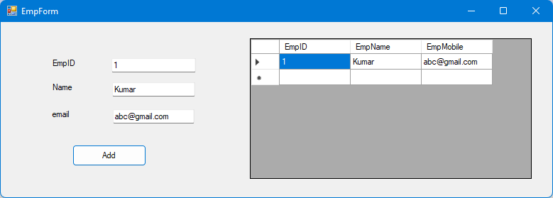
Adding data using Forms
Design a form as shown below:

Slide 10
Add the code as shown below
public partial class EmpForm : Form
{
DataTable EmployeeDetails;
public EmpForm()
{
InitializeComponent();
EmployeeDetails = new DataTable("EmployeeDetails");
//to create the column and schema
DataColumn EmployeeID = new DataColumn("EmpID", typeof(Int32));
EmployeeDetails.Columns.Add(EmployeeID);
DataColumn EmployeeName = new DataColumn("EmpName", typeof(string));
EmployeeDetails.Columns.Add(EmployeeName);
DataColumn EmployeeMobile = new DataColumn("EmpMobile", typeof(string));
EmployeeDetails.Columns.Add(EmployeeMobile);
dataGridView1.DataSource = EmployeeDetails;
}
private void btnAdd_Click(object sender, EventArgs e)
{
EmployeeDetails.Rows.Add(txtEmpID.Text, txtEmpName.Text, txtEmpMobile.Text);
}
}

Slide 11
Thank You

